Slide 1
MIT Research: Effects of Inflation and Volatility on Construction Alternatives
Notes:
Life-Cycle Cost Analysis (LCCA) is an analytical tool that provides a cost comparison between two or more competing design alternatives that provide equivalent benefits for the project being analyzed.
Most LCCAs assume all construction materials have constant real prices. This assumption is the same as assuming that all commodity prices go up with general inflation. When prices rise more (or less) than expected, the projects with larger future costs will be unfairly advantaged (or penalized).

Slide 2
Life-Cycle Cost Analysis: The Basics
Initial Construction Costs
Net
Present
Value, $
Rehabilitation Activity Costs
Maintenance Activity Costs
Discount
to
Present
Value
LCCA Analysis Period, yrs
Salvage Value
Notes:
Costs are calculated in terms of the Net Present Value (NPV), accounting for initial construction costs and future costs including maintenance, rehabilitation and salvage.

Slide 3
Discount Rate
To estimate net present value, future benefits and costs must be discounted.
Discount factors can be reflected in real or nominal terms.
Real Discount Rate - real interest rates from which the inflation premium has been removed (OMB Circular A-94 Appendix C).
Notes:
Within the LCCA framework, it is important to account for the time value of money so that the NPV of future activities can be determined.
In the construction industry the time value of money is typically determined based on the real discount rate which is a function of the anticipated market interest rate less the rate of inflation over the anticipated life of a project. Using the real discount rate implies that the inflation rate of all construction materials matches the general rate of inflation, inferring that the real costs are fixed over time for all building materials.

Slide 4
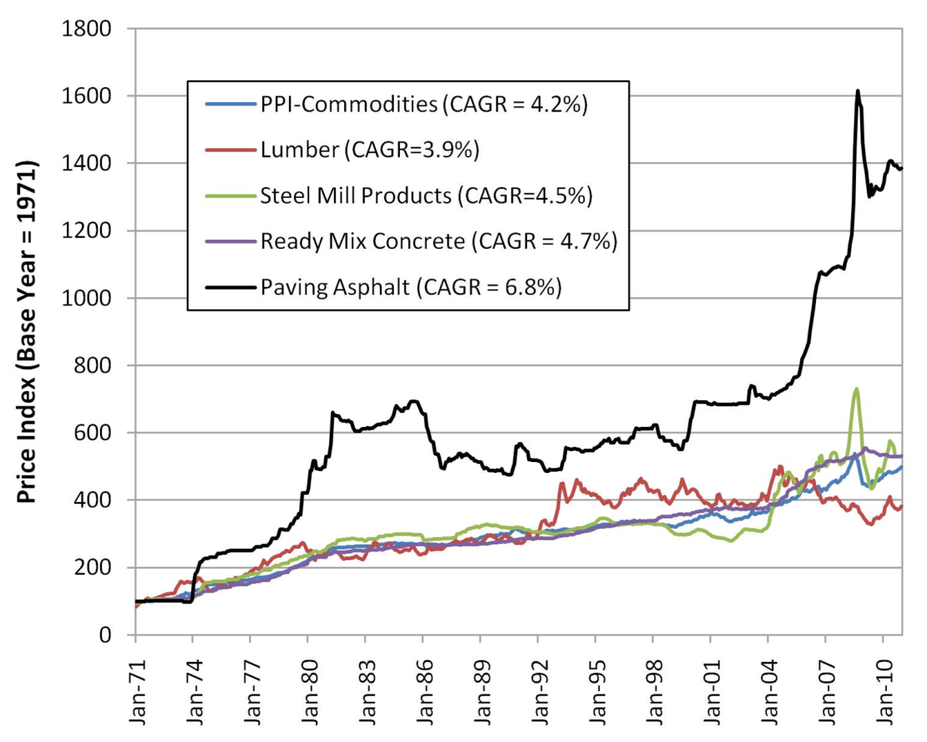
Are Real Costs Constant?
MIT investigated the historical inflation rates of:
  wood,
  steel,
  concrete, and
  asphalt.
Result - inflation rates are quite different.
Notes:
Recent research at the Massachusetts Institute of Technology (MIT) examined historical data on real prices and found that the assumption of constant real costs is inconsistent with historical experience. MIT investigated the historical inflation rates of several construction materials (wood, steel, concrete, and asphalt) and demonstrated that the historical inflation rates for these materials has been quite different (See Figure 1).

Slide 5
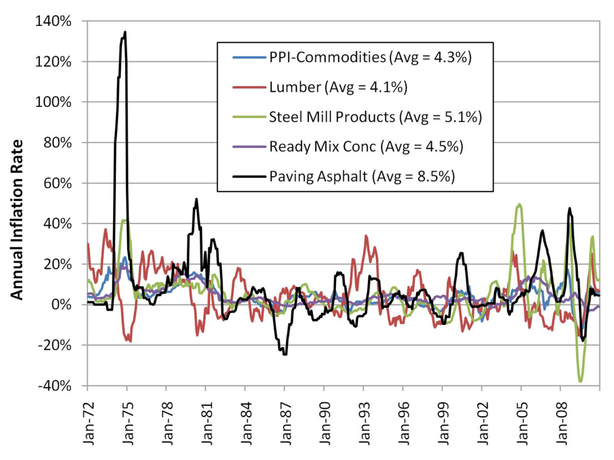
Are Real Costs Constant?
MIT also investigated the historical volatility of the same materials.
Result – volatility is also quite different, especially in the case of asphalt.
Notes:
and in the case of asphalt has been highly volatile (See Figure 2).

Slide 6
Methodology
Conducted a LCCA for an assumed 10-mile, four-lane highway project.
Concrete and asphalt alternatives analyzed using standard designs and maint/rehab schedules.
Performed Monte-Carlo stochastic simulation of 1,000 different LCCA outcomes and historical inflation rates.
Generated a variety of different random possible outcomes.
Notes:
To demonstrate the effect of variable inflation rates, MIT performed a LCCA for an assumed ten-mile, four-lane highway project. A concrete and asphalt alternative were analyzed using standard North Carolina DOT pavement designs and maintenance/rehabilitation strategies. MIT performed a stochastic simulation of 1,000 different LCCA outcomes using a Monte-Carlo simulation and historical inflation rates which generated a variety of different random possible outcomes.

Slide 7
Results – Inflation Rate
In 86% of the simulations the real price of concrete fell over the maintenance period.
In 85% of the simulations asphalt’s real price rose over the course of 40 years.
The cost surprise exceeded 4% of the initial projected cost (on a NPV basis) in half of the cases.
Notes:
It is likely that the actual costs for concrete maintenance would be lower than those assuming constant real costs (as in a typical LCCA)―in 86% of the simulations the real price of concrete fell over the maintenance period.
Asphalt inflation is likely to outstrip overall inflation, meaning that an LCCA assuming constant real costs will exaggerate asphalt’s price competitiveness―in 85% of the simulations asphalt’s real price rose over the course of 40 years.
Based on this analysis, the cost surprise exceeded 4% of the initial projected cost (on a NPV basis) in half of the cases, usually because the asphalt construction turned out to be relatively more expensive than concrete construction.

Slide 8
Results – Price Behavior & Volatility
Asphalt has risen 1.25% per year on average.
Concrete has declined nearly 0.20% in real terms over the same timeframe.
Concrete’s real price volatility is low at 2.9% while asphalt’s volatility is substantially higher at 6.3%.
Lumber and steel’s real price volatility is even higher at three times more than concrete.
Note: Data from the Bureau of Labor Statistics (BLS) for a period of more than 30 years.
Notes:
MIT analyzed the real price behavior of wood, steel, concrete and asphalt using data from the Bureau of Labor Statistics (BLS) for a period of more than 30 years and found: (See slide)

Slide 9
Results – Escalation Rate
Based on a 50 year analysis which accounts for differential inflation rates of construction materials:
  Asphalt’s real cost would rise by nearly 95%.
  The mean annual real escalation rate of concrete is –0.5% while asphalt’s rate is +1.1%.
Notes:
To account for the variable inflation rate of various construction materials, analysts could use an escalation rate to account for the difference in inflation between building materials and the general rate of inflation. MIT conducted another stochastic simulation for 1000 real cost paths for the four basic construction materials over a period of 50 years and found: (See Slide)

Slide 10
Impacts for Transportation Projects
In terms of equality for pavement type selection and LCCA, consider:
  Asphalt’s 40-year historical inflation rate is 2% to 4% higher than that of concrete.
  There is sufficient historical and forecasting evidence that demonstrates this difference will continue in the future.
Notes:
LCCA for road construction is used to determine which pavement design is most cost effective over the analysis period. For LCCA to be reliable, both the engineering inputs and the economic inputs need to accurately reflect the future performance and the time value of money. Current practice assumes that the inflation rate for all materials is the same; however, MIT has demonstrated that this is not the case and determined:
Asphalt’s 40-year historical inflation rate is 2% to 4% higher than that of concrete
There is sufficient historical and forecasting evidence that demonstrates this difference will continue in the future

Slide 11
Recommendations
Continue use of the Office of Management and Budget (OMB) recommended real discount rates in LCCA.
For pavements it is recommended to use the 30-year real discount rate.
For other structures it is recommended to use the 50-year real discount rate (or other appropriate timeframe).
Account for differences in inflation among materials and the general rate of inflation by using an appropriate escalation rate applied at the year(s) of rehabilitation.
Notes:
Recommendations for improving LCCA for construction material selection include: (See Slide)

Slide 12
More Information
Full report available from MIT Concrete Sustainability Hub at web.mit.edu/cshub
MIT Hub established by
  RMC Research & Education Foundations
  Portland Cement Association
NRMCA providing technical support
  Transfer research into practice
  Visit www.nrmca.org
Notes:
The full report titled The Effects of Inflation and Its Volatility on the Choice of Construction Alternatives can be downloaded from the MIT Concrete Sustainability Hub web site at http://web.mit.edu/cshub. The Concrete Sustainability Hub is a research center at MIT that was established by the Ready Mixed Concrete (RMC) Research & Education Foundation and the Portland Cement Association (PCA). NRMCA is providing technical input to the research program and helping transfer the research results into practice.

