Slide 1
MIT Research: Life Cycle Assessment of Residential Buildings
Notes:
Life cycle assessment (LCA) offers a comprehensive methodology for evaluating the environmental impacts
of buildings. Recent research at the Massachusetts Institute of Technology (MIT) explored and advanced key areas relevant to the field of LCA including methodology, benchmarking and impact reduction.

Slide 2
Methodology
Standardized LCA methodology critical
Increase consistency of LCA
MIT proposes good practices for LCA
Notes:
A standardized LCA methodology is critical in order to increase the consistency of LCA for buildings. The MIT research supports standardization by proposing good practices for conducting LCA on buildings.

Slide 3
Methodology
Transparency of data
Define scope
Identify system boundaries
Define functional unit
Notes:
It is important that LCAs use a comprehensive life cycle perspective and provide transparency with regards to the data, scope, boundaries, functional units and other important LCA parameters.

Slide 4
Life Cycle Perspective
Notes:
Drawing boundaries to include all phases of the building life cycle—materials, construction, use (including operating energy), maintenance, and end of life—allows for an accurate representation of cumulative environmental impacts over the life of a building.

Slide 5
Structural Systems Considered
Insulated Concrete Forms (ICF)
Traditional Wood Framing
Notes:
The general methodology was applied to benchmark structures used in residential building applications using Insulated Concrete Form (ICF) construction consisting of concrete walls encased in expanded polystyrene (EPS) insulation, and typical light-frame wood construction.

Slide 6
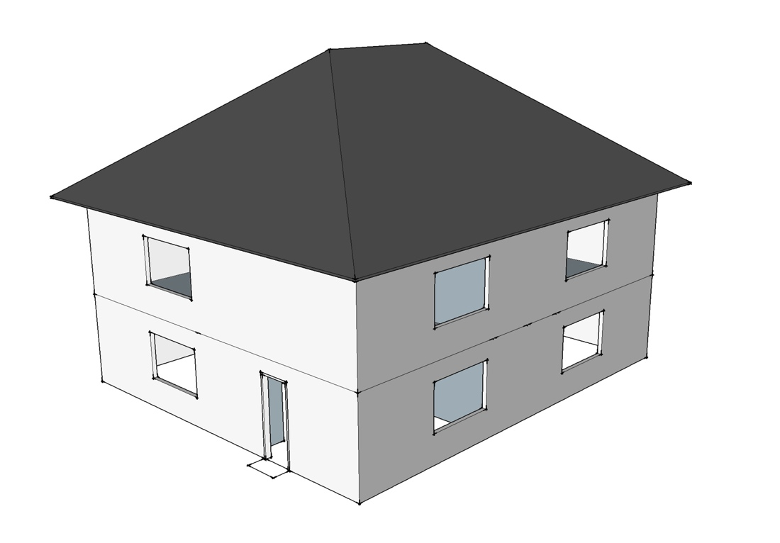
Benchmark Single Family Building
2 stories
2,400 ft²
ICF
Wood
Phoenix
Chicago
Notes:
The first study model considered a two-story, 2400 ft2 (223 m2) single-family building.
The LCAs were carried out for two different cities in the United States, modeling regional and climatic differences: Chicago, representing a cold climate, and Phoenix, representing a hot, dry climate.
To model representative houses for the two different climate regions, the Phoenix house is supported by a slab-on-grade (SOG) and the Chicago house has a basement wall foundation. The only major difference between the light-frame wood and ICF house is the exterior walls.

Slide 7
Benchmark Single Family Building
4 stories
33,763 ft²
ICF
Wood
Phoenix
Chicago
Notes:
Then, a 4-story multi-family apartment building with a total square footage of 33,763 ft2 (3,137 m2) was modeled. Again, the LCAs were carried out for two different cities Chicago and Phoenix.

Slide 8
Benchmark Analysis
60
YEAR
Resources
Water
Global Warming
Potential
Ozone Depletion
Acidification
Eutrophication
Smog Formation
Human Toxicity
Eco Toxicity
Waste
Land Use
Notes:
The annual operating energy, determined using the EnergyPlus building energy analysis software, was conducted for a 60-year life cycle. Benchmark single-family houses are designed and modeled based on the Building America House Simulation Protocol (BAHSP).
The resulting Global Warming Potential (GWP) was then quantified using CO2-equivalents (CO2e) for a number of purposes, including benchmarking emissions for current practices, comparing concrete with wood, and understanding the relative importance of different phases of the life cycle. Global warming potential (CO₂e) quantified for several purposes
Benchmarking emissions of current construction practices
Comparing impacts of concrete versus wood
Understand relative magnitude of relative impacts of different life cycle phases
(Global-warming potential (GWP) is a relative measure of how much heat a greenhouse gas traps in the atmosphere expressed as a factor of carbon dioxide.)

Slide 9
Impacts
Concrete homes have higher embodied GWP in the pre-use phase
Only accounts for 2-12% of life cycle GWP
For cold climate energy savings ICF house
23% of total operating energy
Notes:
Concrete homes have higher embodied GWP in the pre-use phase-but this phase accounts for only about 2-12% of overall GWP for the life of the home.
For a cold climate, such as Chicago, the energy savings of an ICF house built from average to tight levels of air infiltration saves 23% of total operating energy.

Slide 10
Impacts
Notes:
Over a 60-year life cycle, the lower (5%-8% for single family, 4.4%-6.2% for multifamily) operating GWP outweighs the initially equal or higher embodied GWP for ICF buildings. The total life cycle GWP is equal to, or lower than, alternate designs in wood.

Slide 11
Impact Reductions
Reducing ICF core from 6 in. to a 4 in.
Cost effective and reduces emissions
Thicker insulation, increasing tightness and using thinner concrete
Reduces emissions
At Lower than current market pricing of carbon
Increasing SCMfrom 10% to 50%
Can decrease pre-use GWP by 12-14%
Notes:
Moving from a 6 in (15.2 cm) to a 4 in (10.2 cm) core is both cost effective and reduces emissions over the lifetime of the wall assembly, and it should be considered in regions of the country where a 4 in (10.2 cm) core meets structural requirements.
By producing ICF insulation blocks with different panel thicknesses, increasing the tightness of houses, and making a thinner ICF wall, greenhouse gas emissions can be reduced at prices lower than the current market pricing of carbon.
Increasing SCM substitution from 10% to 50% in the ICF house reduces the pre-use GWP by 12% to 14%. Similar results are found for the multifamily study.

Slide 12
Life Cycle Cost
Compared to light-frame wood, ICF
$2.36-$4.09/ft2 ($25-44/m2) of wall area higher in Chicago
-$0.08 to $4.15/ft2 (-$1 to $45/m2) of wall area in Phoenix
Over the total life cycle cost, however, ICF construction increases the price of a house by less than 5%.
Notes:
A major advancement of the MIT research was the incorporation of a cost-effective analysis to determine whether or not a given construction strategy made economic sense. The report found ICF construction is a more expensive construction alternative than light-frame wood construction but offers lower energy costs in the use phase. Accounting for a range of construction costs and discount rates, the relative life cycle costs for ICF construction (compared to light-frame wood) is $2.36-$4.09/ft2 ($25-44/m2) of wall area higher in Chicago and -$0.08 to $4.15/ft2 (-$1 to $45/m2) of wall area in Phoenix. Over the total life cycle cost, however, ICF construction increases the price of a house by less than 5%.

Slide 13
More Information
Full report available from MIT Concrete Sustainability Hub at web.mit.edu/cshub.
MIT Hub established by
RMC Research & Education Foundations
Portland Cement Association
NRMCA providing technical support
Transfer research into practice
Visit www.nrmca.org
Notes:
The full report titled Methods, Impacts, and Opportunities in the Concrete Building Life Cycle can be downloaded from the MIT Concrete Sustainability Hub Web site at http://web.mit.edu/ cshub. The Concrete Sustainability Hub is a research center at MIT that was established by the Ready Mixed Concrete (RMC) Research & Education Foundation and the Portland Cement Association (PCA). NRMCA is providing technical input to the research program and helping transfer the research results into practice.

