Slide 1
MIT Research: Life Cycle Assessment of Residential Buildings
Notes:
Life cycle assessment (LCA) offers a comprehensive methodology for evaluating the environmental impacts
of buildings. Recent research at the Massachusetts Institute of Technology (MIT) explored and advanced key areas relevant to the field of LCA including methodology, benchmarking and impact reduction.

Slide 2


MIT Concrete Sustainability Hub
$10 million investment over 5 years
Funded equally by RMCREF & PCA
NRMCA providing technical support and guidance
NRMCA and state associations to play a critical role in the technology transfer
Notes:
In 2009, the Ready Mixed Concrete Research & Education Foundation partnered with PCA to establish the Concrete Sustainability Hub at MIT
Funded by a $10 million investment over next 5 years, the Hub has three principal goals:
Identify areas in which concrete excels compared to other materials
Identify opportunities for improvements
Create solid technical basis for future industry development

Slide 3
Goals
Identify areas in which concrete excels
Identify opportunities for improvement
Create solid technical basis for future industry development
Social
Environment
Economic
Sustainable
Notes:
The goals of the research are:
Identify areas in which concrete excels
Identify opportunities for improvement
Create solid technical basis for future industry development

Slide 4
3 Research Platforms
Concrete Science
Scientific breakthroughs toward reducing the CO₂ footprint of cement and concrete
Econometrics
Impact on economy:
- System dynamics
- Effect on policy (e.g. Carbon Tax
Building Technology
The CO₂ footprint of concrete structures
- Material Flows
- Life Cycle Assessment
Notes:
The Hub is organized into three areas or platforms:
Concrete Science
Building Technology
And Econometrics
This interdisciplinary approach will provide us a unique opportunity to:
Develop a comprehensive analysis of where we are today
Be leaders in advancing even greater sustainability in construction
And better understand the economic impacts of sustainable construction solutions
MIT has truly assembled a “dream team” of researchers to work together through the Hub.

Slide 5


Concrete Science Platform: Mission
Scientific breakthroughs toward reducing CO2 footprint of cement and concrete
  Strength with less material
  Lower energy processing
  Chemical stability
Notes:
One of the most critical issues for a sustainable development of concrete as the backbone material for infrastructure and housing is to address the CO2 footprint of concrete materials. The MIT concrete science team are proposing new ways to address this issue. Some strategies include producing higher cement mortar strengths with less material, reducing the energy of cement processing and improving chemical stability.

Slide 6
Building Technology Platform
Mission: Life Cycle Assessment (LCA) of Concrete Buildings and Pavements to Identify Impacts and Opportunities
Research Topics:
  Material Flow Analysis
  LCA of commercial buildings
  LCA of residential buildings
  LCA of pavements
  LCCA of building materials
Notes:
The Building Technology Platform has the following Mission:
Life Cycle Assessment (LCA) of Concrete Buildings and Pavements to Identify Impacts and Opportunities
Research Topics:
Material Flow Analysis
LCA of commercial buildings
LCA of residential buildings
LCA of pavements
LCCA of building materials

Slide 7
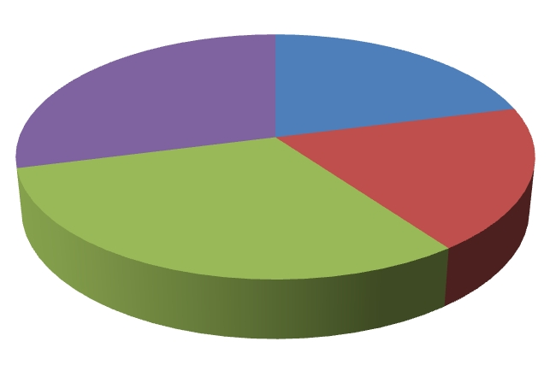
Residential Buildings
Greenhouse Gas Emissions
Residential
Buildings: 21%
Industry: 29%
Commercial
Buildings: 19%
Transportation: 31%
Notes:
In the U.S., operating residential buildings emit 21% of all the greenhouse gases emitted in the country. Therefore, it makes sense for us to look at ways to improve energy efficiency. Life cycle assessment offers a tool and methodology for us to identify potential energy savings.

Slide 8
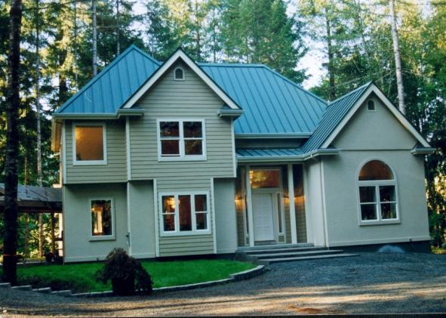
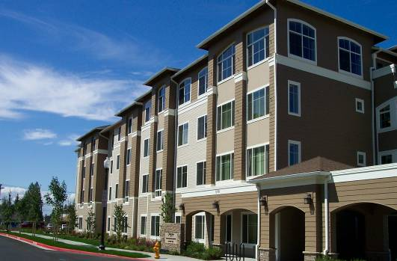
Methodology
Standardized LCA methodology critical
Increase consistency of LCA
MIT proposes good practices for LCA
Notes:
A standardized LCA methodology is critical in order to increase the consistency of LCA for residential buildings. The MIT research supports standardization by proposing good practices for conducting LCA on buildings.

Slide 9
Methodology
Transparency of data
Define scope
Identify system boundaries
Define functional unit
Notes:
It is important that LCAs use a comprehensive life cycle perspective and provide transparency with regards to the data, scope, boundaries, functional units and other important LCA parameters.

Slide 10

Transparency
Notes:
While the MIT study quantified the carbon emission impact of building systems over its complete life cycle, the approach MIT took is as important as the findings.
The strength of the MIT research lies in its detailed and transparent methodology of the analysis of the harvested raw materials, construction, operating (or use) phases of the life cycle of the building. Information on system boundaries and processes allocation was clearly outlined and peer reviewed. This provides an essential baseline for both policy and design discussions to a range of audiences. Thus, sharing the story of their analysis to stakeholders in a meaningful, replicable way, which is the most important part of the process.
The development of an open and replicable LCA process for buildings is central to the reported research, and examples are presented of the application of the LCA methodology to evaluate residential and commercial buildings that are constructed with concrete, wood, and steel.

Slide 11
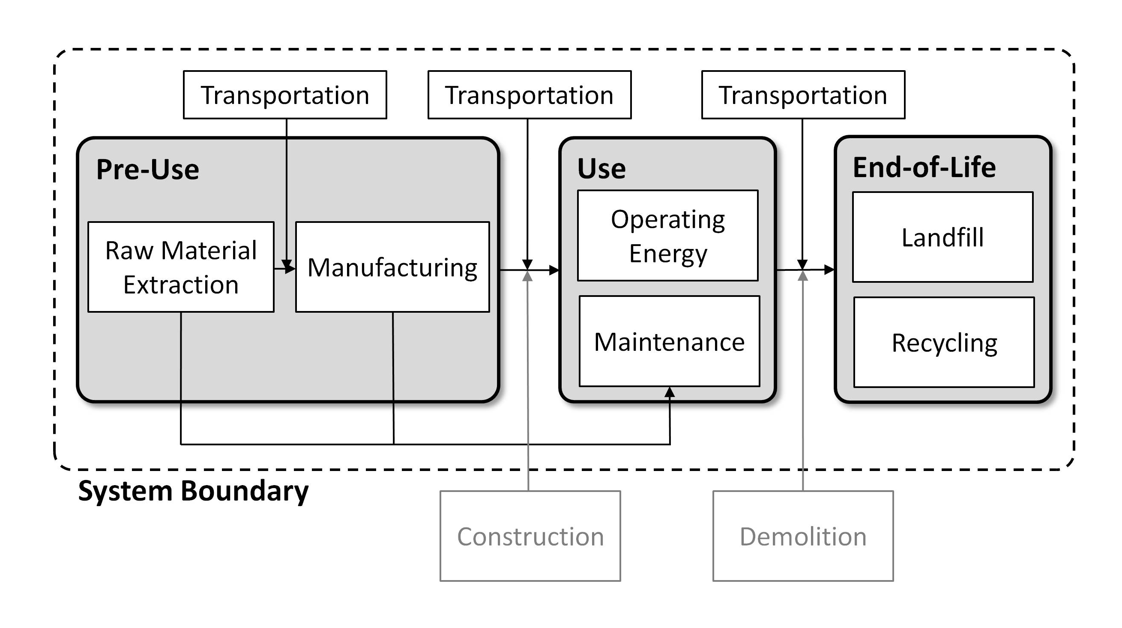
Life Cycle Perspective
Notes:
Drawing boundaries to include all phases of the building life cycle—materials, construction, use (including operating energy), maintenance, and end of life—allows for an accurate representation of cumulative environmental impacts over the life of a building.

Slide 12

Functional Unit
Notes:
The functional unit is the useable area for each building type. For ease of comparison, results are also reported on a per square foot (and m2) basis.
In commercial leasing, Usable Square Feet simply means the square footage that is rented to be used exclusively by the tenant. Usable square feet includes private (tenant-only) rest rooms, closets, storage and any other areas used only by the tenant (computed as the square footage contained within the demising partitions).

Slide 13
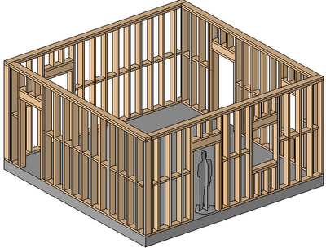
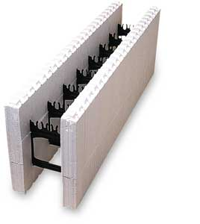
Structural Systems Considered
Insulated Concrete Forms (ICF)
Traditional Wood Framing
Notes:
The general methodology was applied to benchmark structures used in residential building applications using Insulated Concrete Form (ICF) construction consisting of concrete walls encased in expanded polystyrene (EPS) insulation, and typical light-frame wood construction.

Slide 14
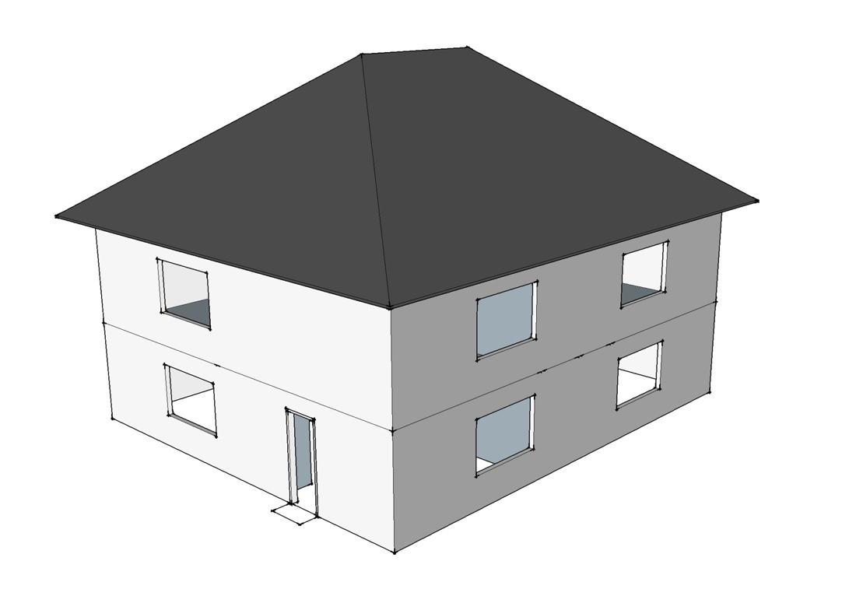


Benchmark Single Family Building
2 stories
2,400 ft²
ICF
Wood
Phoenix
Chicago
Notes:
The first study model considered a two-story, 2400 ft2 (223 m2) single-family building.
The LCAs were carried out for two different cities in the United States, modeling regional and climatic differences: Chicago, representing a cold climate, and Phoenix, representing a hot, dry climate.
To model representative houses for the two different climate regions, the Phoenix house is supported by a slab-on-grade (SOG) and the Chicago house has a basement wall foundation. The only major difference between the light-frame wood and ICF house is the exterior walls.

Slide 15
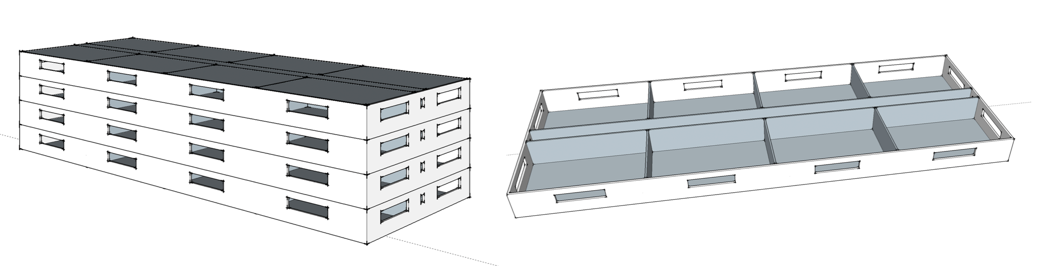
Benchmark Multi-Family Building
4 stories
33,763 ft²
ICF
Wood
Phoenix
Chicago
Notes:
Then, a 4-story multi-family apartment building with a total square footage of 33,763 ft2 (3,137 m2) was modeled.
Again, the LCAs were carried out for two different cities Chicago and Phoenix.

Slide 16
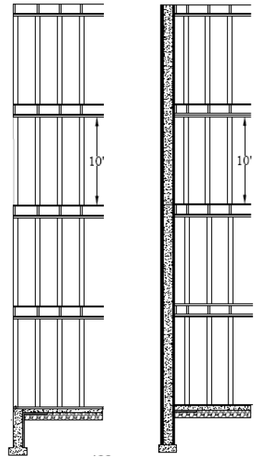
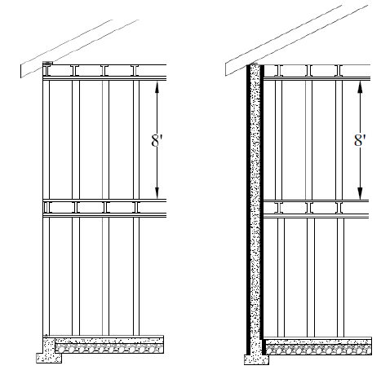
Structures
2 stories
Single Family
4 stories
Multi-Family

Slide 17


Energy Modeling
60
YEAR
Notes:
The operating energy is obtained by modeling the energy required for lighting, plug loads, hot water, and HVAC requirements.
The annual operating energy, determined using the EnergyPlus building energy analysis software, was conducted for a 60-year life cycle. Benchmark single-family houses are designed and modeled based on the Building America House Simulation Protocol (BAHSP). The BAHSP is a US Dept of Energy program to study market-ready energy efficiency solutions for the American home. For the multi-family, the Dept of Energy benchmark building file was update to ASHRAE 90.1 (2007) standards.

Slide 18

Benchmark Analysis
CO²
equivalent
Resources
Water
Global Warming
Potential
Ozone Depletion
Acidification
Eutrophication
Smog Formation
Human Toxicity
Eco Toxicity
Waste
Land Use
Notes:
The resulting Global Warming Potential (GWP) was then quantified using CO2-equivalents (CO2e) for a number of purposes, including benchmarking emissions for current practices, comparing concrete with wood, and understanding the relative importance of different phases of the life cycle. Global warming potential (CO₂e) quantified for several purposes
Benchmarking emissions of current construction practices
Comparing impacts of concrete versus wood
Understand relative magnitude of relative impacts of different life cycle phases
In particular, their work demonstrates that there are measureable differences between various construction materials, and that concrete structures can provide unique benefits compared to other materials over an operating life cycle.
(Global-warming potential (GWP) is a relative measure of how much heat a greenhouse gas traps in the atmosphere expressed as a factor of carbon dioxide.)

Slide 19
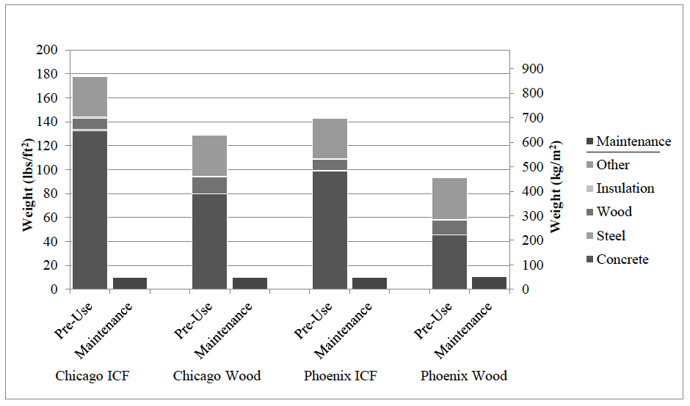
Weight of Materials(lbs/sf²)
Notes:
The calculation of material quantities was the first step in data collection. The structure is designed, keeping the floor plan the same across each building type, and material weights are calculated using standard densities.
Concrete, the dominant material by mass for all of the cases, is much greater in Chicago than Phoenix because of the basement wall foundation. The ‗other‘ category includes stucco for the exterior, gravel and waterproofing for the foundation, drywall, paint, and windows. The major contributor of mass for the ‗other‘ and ‗maintenance‘ categories are the 6 in (152 mm) underlayment of gravel and the asphalt shingles for the roof.

Slide 20
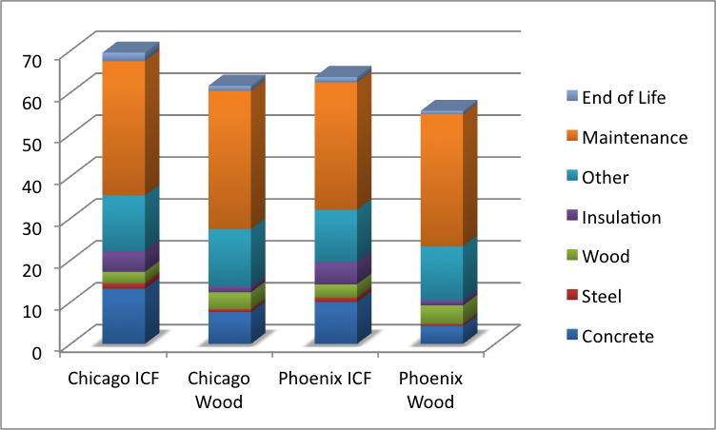
Embodied Emissions
Notes:
Embodied emissions include:
Pre-use
Maintenance
End-of-life
Concrete homes have a higher embodied GWP associated with the pre-use phase of LCA. The total embodied GWP for ICF houses is 13% higher in Chicago and 14% higher in Phoenix than light-frame wood houses.
Concrete accounts for 10-13 lbs CO2e/ft2) in the ICF houses and 4-8 lbs CO2e/ft2 (20-39 kg CO2e/m2) in the light-frame wood houses.
This is 7.8%-19% of the embodied life cycle emissions due to materials.

Slide 21
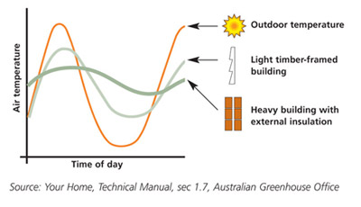
Thermal Mass Benefits
Notes:
The MIT research uncovered concrete’s ability to offer a highly resilient structure while providing thermal mass benefits for energy loads – impacting the environmental footprint of the structure.
It is not news to you…
The benefits of the high thermal mass of the ICF building, such as heat absorption and thermal lag, are delaying transfer of heat to inside or outside of the building. It therefore moderates indoor temperature swings and reduces the amount of heating or cooling needed

Slide 22
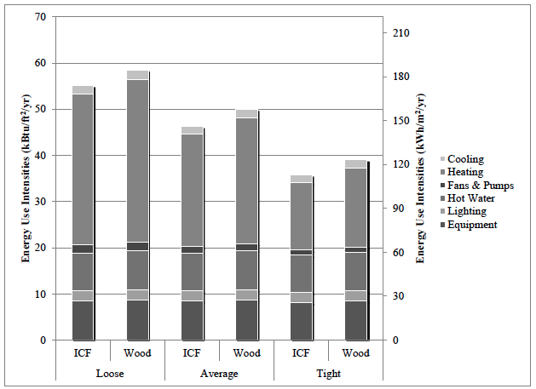
Annual Energy Use Intensity (Chicago)
Notes:
For Chicago, the ICF houses use 5.8%, 7.4% and 8.4% less energy than the equivalent light-frame wood house for loose, average and tight construction, respectively. The ICF houses have slightly higher R-values and greater thermal mass, which accounts for the lower energy consumption. Based on energy simulations of the single-family model, the difference in R-value is more important than the difference in thermal mass.

Slide 23
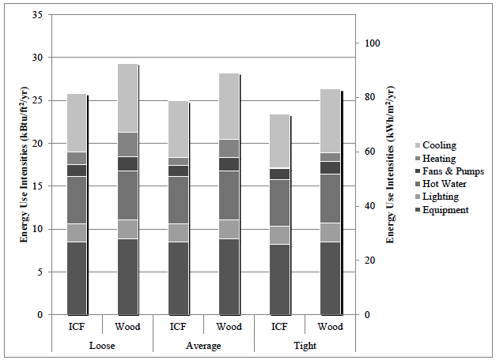
Annual Energy Use Intensity (Phoenix)
Notes:
In Phoenix, the percentage difference between ICF and wood is larger, with ICF using 11.9%, 11.6% and 11.0% less energy than wood for loose, average and tight constructions respectively. This is due to the fact that ICF walls have even higher R-values than what code requires in a mild climate (Table 3.4), and higher thermal mass than their wood counterparts.

Slide 24
Impacts
The GWP of the ICF house in is approximately 6%-10% lower than the light-frame wood house.
Over a 60-year life cycle, the lower (5%-8% for single family, 4.4%-6.2% for multifamily) operating GWP outweighs the initially equal or higher embodied GWP for ICF buildings.
Notes:
For a cold climate, such as Chicago, the energy savings of an ICF house built from average to tight levels of air infiltration saves 23% of total operating energy.
Over a 60-year life cycle, the lower (5%-8% for single family, 4.4%-6.2% for multifamily) operating GWP outweighs the initially equal or higher embodied GWP for ICF buildings. The total life cycle GWP is equal to, or lower than, alternate designs in wood.
Annually,
Chicago - 12.7 lbs CO2e/ft2/yr vs. 13.6 lbs CO2e/ft2/yr)
Phoenix - 8.18 lbs CO2e/ft2 vs. 9.12 lbs CO2e/ft2/yr
Regional variation has a major impact on the life cycle of these single-family houses. Assuming a 60-year lifetime, a house in Phoenix has over 30% lower emissions than a house in Chicago, due to the milder climate of Phoenix. Transportation emissions for the building materials account for only a small fraction of the embodied GWP, and are almost negligible over the full life cycle.

Slide 25
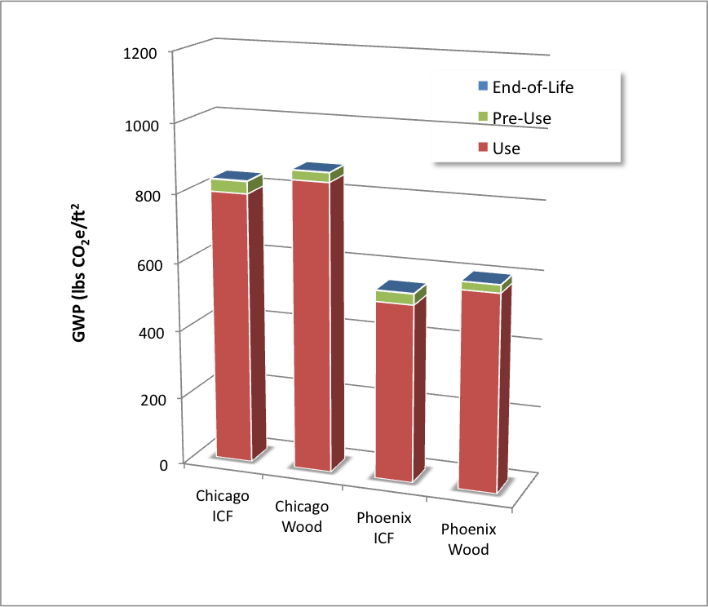
Impacts
Notes:
The embodied phase accounts for only about 2 to 12% of the overall global warming potential for the life of the home. Single family and multi-family show similar results. (Multifamily - The 60 year cumulative emissions of the concrete buildings are 2.8% lower in Chicago and 5.0% lower in Phoenix than the equivalent wood framed building. )
The MIT research considered the buildings’ operational life as a whole system rather than the component material. During its life, a building (single family or multi-family) uses considerable energy. Energy use during the life of a structure is a key element in computing its environmental impact and is also a factor widely recognized for its importance. Each material makes a contribution to the thermal insulation, thereby affecting energy use. Energy use is strongly affected by the mechanical systems used to heat and cool the structure and is thus directly affected by both design and materials.
The term ‗operating‘ refers only to the energy and emissions associated with the operation of the building throughout the use phase.

Slide 26
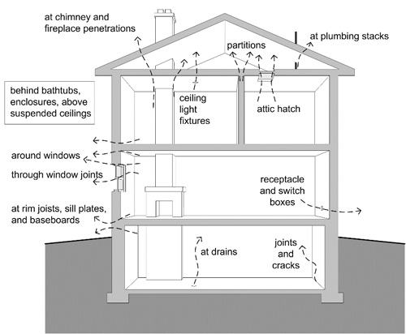
Impact Reduction - Air Tightness
Notes:
Life cycle thinking helps organizations understand and improve their environmental performance while maintaining or improving profits. The MIT study offered a number of improvement opportunities. For ICF structures, significant enhancements were modeled to reduce the buildings lifetime carbon emissions.
Air Infiltration could be described as the unintentional introduction of outside air into a building – also known as air leakage. Besides the obvious sources of infiltration such as cracks in the building envelope or through windows and doors, infiltration occurs through insulation gaps in the wall cavity and post-construction leakage due to the movement of the wood framing. The air tightness of homes can have a major impact on the HVAC operating energy, and therefore we collected new data to give higher confidence in the air-infiltration values. New blower-door tests of ICF homes across the United States have demonstrated a tight construction system with corresponding advantages in reduced operating energy.
Structures built with ICFs provides a tight air barrier, reducing the air infiltration and leaving you with fewer penetration sources, i.e. windows and doors, which are easy to identify and seal.

Slide 27
Other Impact Reductions
ICF - 6 in core to a 4 in core
Increasing SCM (such as fly ash) from 10% to 50%. Can decrease pre-use GWP by 12-14%
Notes:
Moving from a 6 in (15.2 cm) to a 4 in (10.2 cm) core is both cost effective and reduces emissions over the lifetime of the wall assembly, and it should be considered in regions of the country where a 4 in (10.2 cm) core meets structural requirements.
By producing ICF insulation blocks with different panel thicknesses, increasing the tightness of houses, and making a thinner ICF wall, greenhouse gas emissions can be reduced at prices lower than the current market pricing of carbon.
Similar to the commercial building model, increasing (supplementary cementitious materials) SCM substitution from 10% to 50% in the ICF house reduces the pre-use GWP by 12% to 14%. Similar results are found for the multifamily study.

Slide 28

Life Cycle Cost Analysis
Notes:
A major advancement of the MIT research was the incorporation of a cost-effective analysis to determine whether or not a given construction strategy made economic sense.
Two important factors in any LCCA are the time frame of the study and the discount rate. Predicting the exact expected useful life of a building is not possible; however, a time frame of 60 years is used for the analysis, to correspond to the LCA analysis period described above. The real discount rate takes into account the time value of money.
Beyond understanding the economic implications of different construction systems, the goal of this research is to combine the understanding of economic and environmental implications of different types of construction to realize more sustainable solutions. Cost is an important consideration by all builders and consumers, but most previous work has focused on understanding the environmental impacts of different forms of construction. There is a lack of research, however, that integrates the two together to determine which environmental reductions are economically sound decisions.
(used real discount rate of 2.3%, the real discount rate for 2011 provided by Circular A-94 which governs the discount rate for regulatory analysis, as the expected discount rate (Office of Management and Budget 2010))

Slide 29
Life Cycle Cost
Compared to light-frame wood, ICF
$2.36-$4.09/ft2 ($25-44/m2) of wall area higher in Chicago
-$0.08 to $4.15/ft2 (-$1 to $45/m2) of wall area in Phoenix
Over the total life cycle cost, however, ICF construction increases the price of a house by less than 5%.
Notes:
The report found ICF construction is a more expensive construction alternative than light-frame wood construction but offers lower energy costs in the use phase. Accounting for a range of construction costs and discount rates, the relative life cycle costs for ICF construction (compared to light-frame wood) is $2.36-$4.09/ft2 ($25-44/m2) of wall area higher in Chicago and -$0.08 to $4.15/ft2 (-$1 to $45/m2) of wall area in Phoenix.
That is to put it in dollars for the total wall area, $2,425 (per floor) in our Chicago single family model ($3.25x752sf), mid range. And $1,530 (per floor) ($2.04x752sf) mid range in Phoenix.
The focus of this LCCA is to understand the economic and environmental impact of the thermal performance of different wall systems in residential construction.
Over the total life cycle cost, however, ICF construction increases the price of a house by less than 5%.

Slide 30
More Information
Full report available from MIT Concrete Sustainability Hub at web.mit.edu/cshub.
MIT Hub established by
  RMC Research & Education Foundations
  Portland Cement Association
NRMCA providing technical support
  Transfer research into practice
  Visit www.nrmca.org
Notes:
The full report titled Methods, Impacts, and Opportunities in the Concrete Building Life Cycle can be downloaded from the MIT Concrete Sustainability Hub web site at http://web.mit.edu/ cshub. The Concrete Sustainability Hub is a research center at MIT that was established by the Ready Mixed Concrete (RMC) Research & Education Foundation and the Portland Cement Association (PCA). NRMCA is providing technical input to the research program and helping transfer the research results into practice.

