Slide 1
MIT Research: Life Cycle Assessment of Concrete Pavements
Notes:
Life cycle assessment (LCA) offers a comprehensive approach to evaluating and improving the environmental impacts of concrete pavements. Recent research at the Massachusetts Institute of Technology (MIT) explores and advances key areas relevant to the field of pavement LCA: methodology, benchmarking and impact reduction.

Slide 2
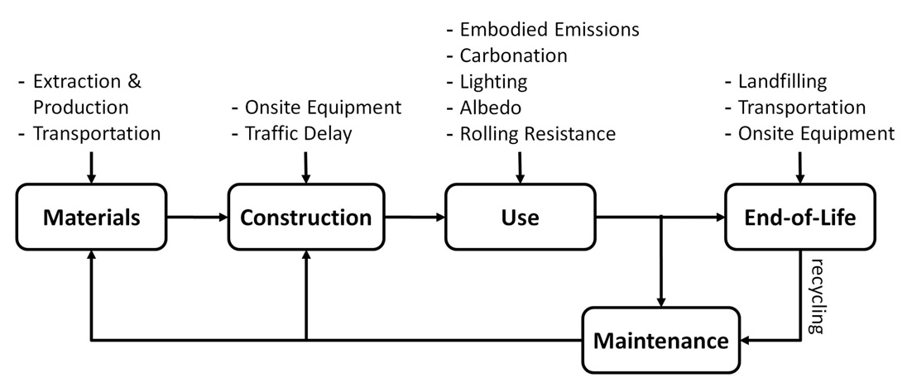
Methodology
Suggested System Boundaries
Notes:
Methodology
The US roadway system is a complex web of approximately 2.6 million miles of public roadways upon which approximately three trillion vehicle miles are traveled every year. US EPA indicates that road transport contributes the most green house gas (GHG) emissions of any transport mode. Additionally, construction and maintenance of these roadways consume energy and resources. For these reasons, there is a growing desire to identify opportunities to reduce GHG emissions during construction, operation and maintenance of roadways. Researchers employed standardized LCA methodology to assess the environmental impact of concrete pavements to encompass the entire life cycle―materials, construction, use, maintenance, and end-of-life. This allowed researchers to quantify cumulative environmental impacts and provide ways to reduce GHG emissions.

Slide 3
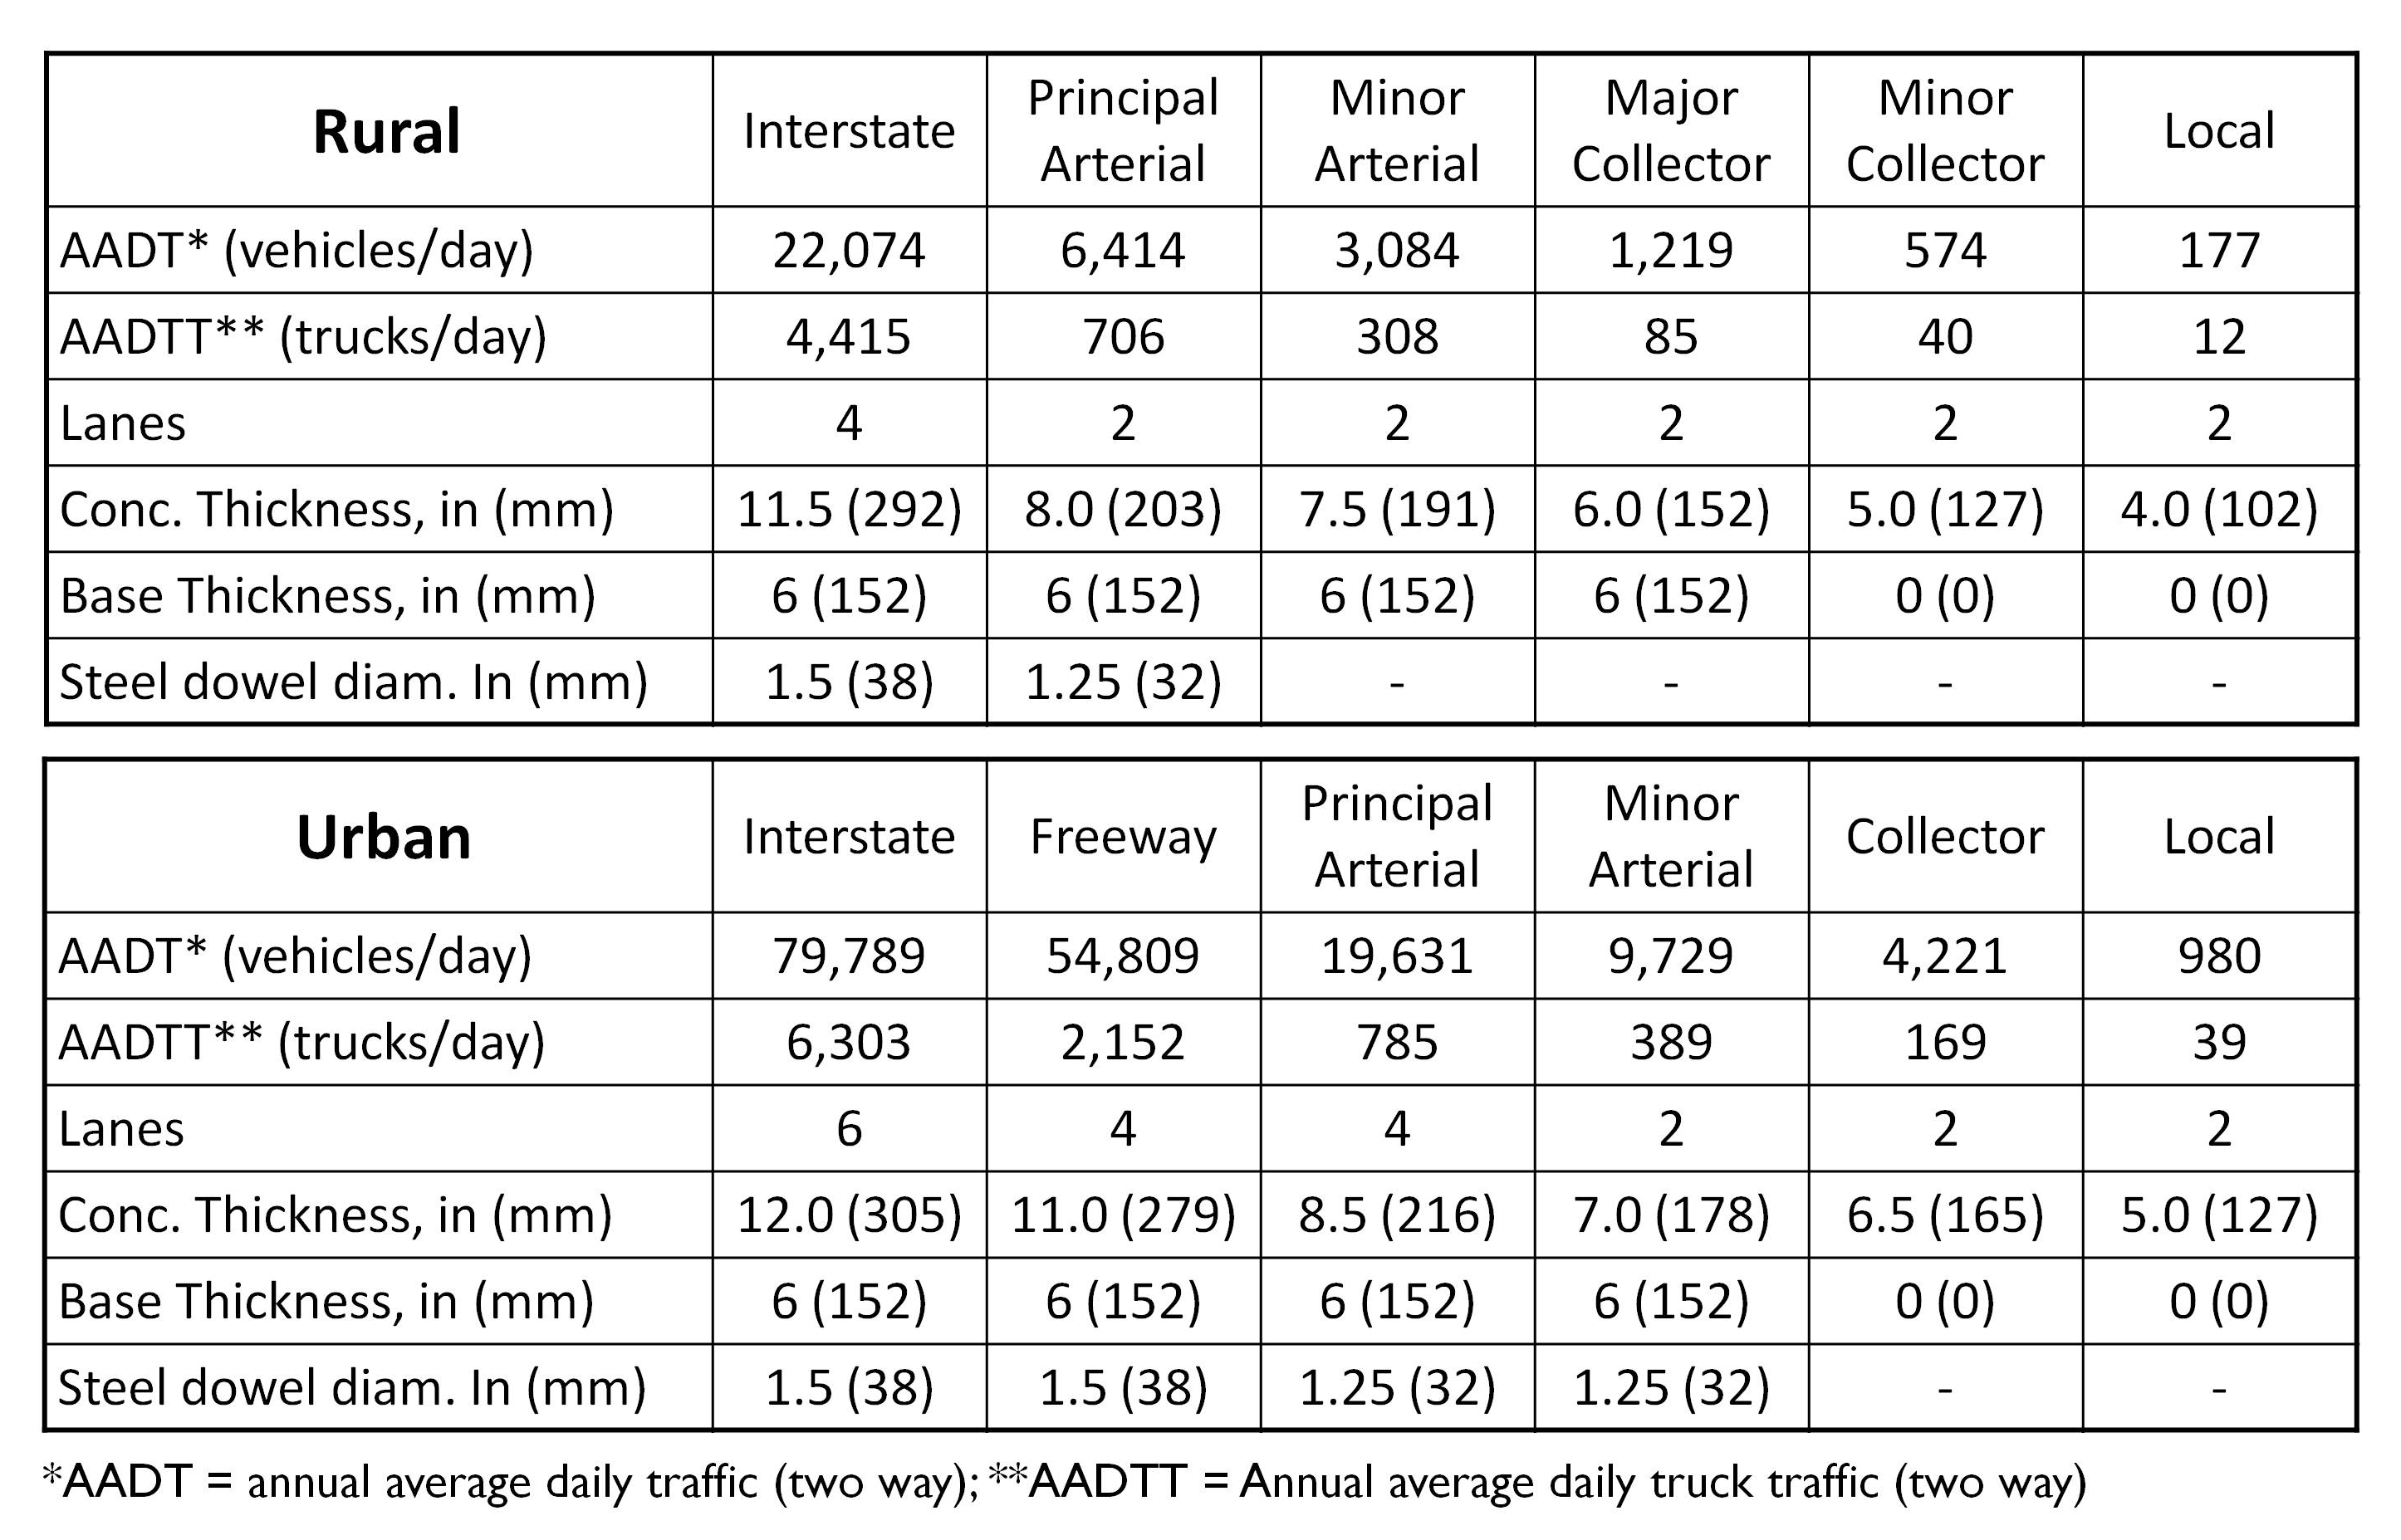
Benchmarking
Notes:
Benchmarking
The LCA methodology was applied to benchmark twelve pavement designs based on FHWA (Federal Highway Administration) roadway classifications ranging from rural local roads to urban interstates. The designs were developed using 1993 AASHTO Method for the Design of Pavement Structures to capture the current state of practice used by most government agencies. Global Warming Potential (GWP), measured in terms of carbon dioxide equivalents (CO2e), were determined for each life cycle phase for the 12 pavement designs to quantify the relative importance of each life cycle phase and identify specific strategies to reduce GWP of concrete pavements.

Slide 4
Impacts
GWP of concrete pavements ranged from:
600 tons CO₂e/mi (340 Mg CO₂e/km) on rural local roads
11,000 tons CO₂e/mi (6,300 Mg CO₂e/km) on urban interstates.
Notes:
Impacts
Results from the research indicate:
-GWP of concrete pavements ranged from 600 tons CO2e/mi (340 Mg CO2e/km) on rural local roads to 11,000 tons CO2e/mi (6,300 Mg CO2e/km) on urban interstates.

Slide 5
Impacts
GHG emissions from cement production are the largest contributor
45% for urban interstates
72% for rural local roads
Notes:
-GHG emissions from cement production are the largest contributor―45% for urban interstates to 72% for rural local roads

Slide 6
Impacts
For 9 of 12 pavement designs
Second largest contributor to GWP is fuel consumed from roughness
Notes:
- For 9 of 12 pavement designs, the second largest contributor to GWP is fuel consumed from roughness.

Slide 7
Impact Reduction
Increasing fly ash from 10% to 30% GWP could be reduced by:
15% for urban interstates
36% for local roads
Increasing albedo reduces urban heat island
43% reduction in GWP
Notes:
There are a number of potential GHG emissions reduction strategies for concrete pavements that were explored by MIT, and LCA provides guidance for future environmental improvements. Notable results regarding potential reduction strategies include:
- GWP could be reduced by 15% for urban interstates to 36% for local roads by increasing the percentage of fly ash in concrete from 10% to 30%
-Increasing the albedo of concrete reduces the urban heat island effect resulting in 43% reduction in GWP

Slide 8
Impact Reduction
Carbonation through crushing and stockpiling concrete for one year
sequestered 28% of initial CO₂ released
Reducing roughness through extra pavement rehabilitations
Reduces GWP by 13% for urban interstates
Increases GWP for rural local roads by 10%
Notes:
-Carbonation through crushing and stockpiling concrete for one year sequestered 28% of initial CO2 released.
-Reducing roughness through extra pavement rehabilitations reduces GWP by 13% for urban interstates but increases GWP for rural local roads by 10%.

Slide 9
Impact Reduction
Notes:
Implementing all four strategies could decrease GWP from 38% for urban interstates to 58% for urban local roads

Slide 10
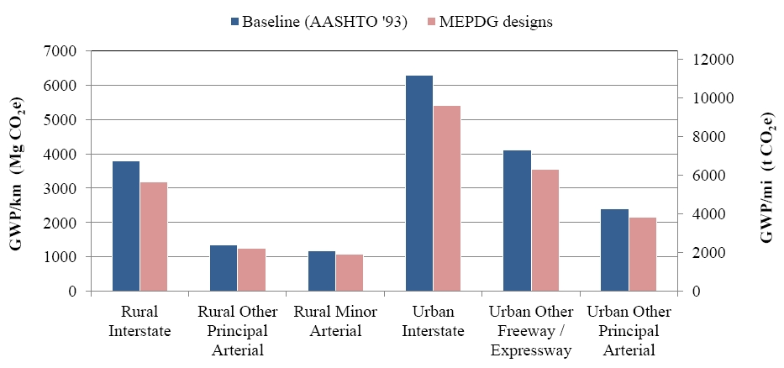
Impact Reduction
Notes:
Another way to decrease GWP is to provide more cost effective pavement designs using state-of-the-art design methodologies. For example, utilizing AASHTO Mechanistic Empirical Pavement Design Guide (MEPDG) in lieu of 1993 AASHTO Design Guide could reduce GWP by up to 17% for rural interstates.

Slide 11
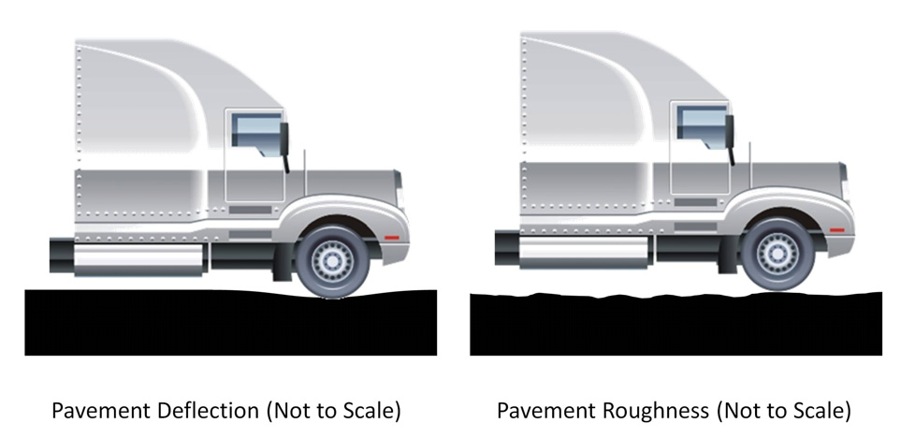
Pavement Vehicle Interaction
Mechanistic model for pavement deflection
Asphalt pavement 1.6 times thicker than an equivalent concrete pavement to achieve the same fuel consumption.
Notes:
Pavement-vehicle interaction (PVI) describes the effect of pavement properties on vehicle fuel consumption. The effect of PVI on fuel consumption over a full life cycle can be significant. Roughness and deflection are the main contributors to higher fuel consumption
MIT developed a mechanistic model to draw a relationship between pavement deflection and fuel consumption. It validated the model by comparing results to existing field data. The mechanistic model calculates that an asphalt pavement would need to be 1.6 times thicker than an equivalent concrete pavement to achieve the same fuel consumption.

Slide 12
More Information
Full report available from MIT Concrete Sustainability Hub at web.mit.edu/cshub
MIT Hub established by
RMC Research & Education Foundations
Portland Cement Association
NRMCA providing technical support
Transfer research into practice
Visit www.nrmca.org
Notes:
The full report titled Methods, Impacts, and Opportunities in the Concrete Pavement Life Cycle can be downloaded from the MIT Concrete Sustainability Hub web site at http://web.mit.edu/cshub. The Concrete Sustainability Hub is a research center at MIT that was established by the Ready Mixed Concrete (RMC) Research & Education Foundation and the Portland Cement Association (PCA). NRMCA is providing technical input to the research program and helping transfer the research results into practice.

