Slide 1
MIT Research: LCA of
Concrete Pavements
Notes:
Life cycle assessment (LCA) offers a comprehensive approach to evaluating and improving the environmental impacts of concrete pavements. Recent research at the Massachusetts Institute of Technology (MIT) explores and advances key areas relevant to the field of pavement LCA: methodology, benchmarking and impact reduction.

Slide 2


MIT Concrete Sustainability Hub
$10 million investment over 5 years
Funded equally by RMCREF & PCA
NRMCA providing technical support and guidance
NRMCA and state associations to play a critical role in the technology transfer
Notes:
In 2009, the Ready Mixed Concrete Research & Education Foundation partnered with PCA to establish the Concrete Sustainability Hub at MIT
Funded by a $10 million investment over 5 years, the Hub has three principal goals:
Identify areas in which concrete excels compared to other materials
Identify opportunities for improvements
Create solid technical basis for future industry development

Slide 3
Goals
Identify areas in which concrete excels
Identify opportunities for improvement
Create solid technical basis for future industry development
Social
Environment
Economic
Sustainable
Notes:
The goals of the research are:
Identify areas in which concrete excels
Identify opportunities for improvement
Create solid technical basis for future industry development

Slide 4
3 Research Platforms
Concrete Science
Scientific breakthroughs toward reducing the CO₂ footprint of cement and concrete
Econometrics
Impact on economy:
- System dynamics
- Effect on policy (e.g. Carbon Tax
Building Technology
The CO₂ footprint of concrete structures
- Material Flows
- Life Cycle Assessment
Notes:
The Hub is organized into three areas or platforms:
Concrete Science
Building Technology
And Econometrics
This interdisciplinary approach will provide us a unique opportunity to:
Develop a comprehensive analysis of where we are today
Be leaders in advancing even greater sustainability in construction
And better understand the economic impacts of sustainable construction solutions
MIT has truly assembled a “dream team” of researchers to work together through the Hub.

Slide 5


Concrete Science Platform: Mission
Scientific breakthroughs toward reducing CO2 footprint of cement and concrete
  Strength with less material
  Lower energy processing
  Chemical stability
Notes:
One of the most critical issues for a sustainable development of concrete as the backbone material for infrastructure and housing is to address the CO2 footprint of concrete materials. The MIT concrete science team are proposing new ways to address this issue. Some strategies include producing higher cement mortar strengths with less material, reducing the energy of cement processing and improving chemical stability.

Slide 6
Building Technology Platform
Mission: Life Cycle Assessment (LCA) of Concrete Buildings and Pavements to Identify Impacts and Opportunities
Research Topics:
  Material Flow Analysis
  LCA of commercial buildings
  LCA of residential buildings
  LCA of pavements
  LCCA of building materials
Notes:
The Building Technology Platform has the following Mission:
Life Cycle Assessment (LCA) of Concrete Buildings and Pavements to Identify Impacts and Opportunities
Research Topics:
Material Flow Analysis
LCA of commercial buildings
LCA of residential buildings
LCA of pavements
LCCA of building materials

Slide 7
LCA of Concrete Pavements
2.6 million miles of public roadways
3 trillion vehicle miles
Road transport contribute most GHG of any transport mode
Construction and maintenance consumes energy and resources
Notes:
The US roadway system is a complex web of approximately 2.6 million miles of public roadways upon which approximately three trillion vehicle miles are traveled every year. US EPA indicates that road transport contributes the most green house gas (GHG) emissions of any transport mode. Additionally, construction and maintenance of these roadways consume energy and resources. For these reasons, there is a growing desire to identify opportunities to reduce GHG emissions during construction, operation and maintenance of roadways.

Slide 8

Methodology
Standardized LCA methodology critical
Increase consistency of LCA
MIT proposes good practices for LCA
Notes:
A standardized LCA methodology is critical in order to increase the consistency of LCA for pavements. The MIT research supports standardization by proposing good practices for conducting LCA on pavements.

Slide 9
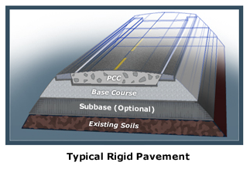
Methodology
Transparency of data
Define scope
Identify system boundaries
Define functional unit
Notes:
It is important that LCAs use a comprehensive life cycle perspective and provide transparency with regards to the data, scope, boundaries, functional units and other important LCA parameters.

Slide 10

Goal and Scope
Assess environmental impact of concrete pavements
For entire life cycle
Quantify cumulative environmental impacts
Ways to reduce GHG emissions
Notes:
Researchers employed standardized LCA methodology to assess the environmental impact of concrete pavements to encompass the entire life cycle―materials, construction, use, maintenance, and end-of-life. This allowed researchers to quantify cumulative environmental impacts and provide ways to reduce GHG emissions.

Slide 11
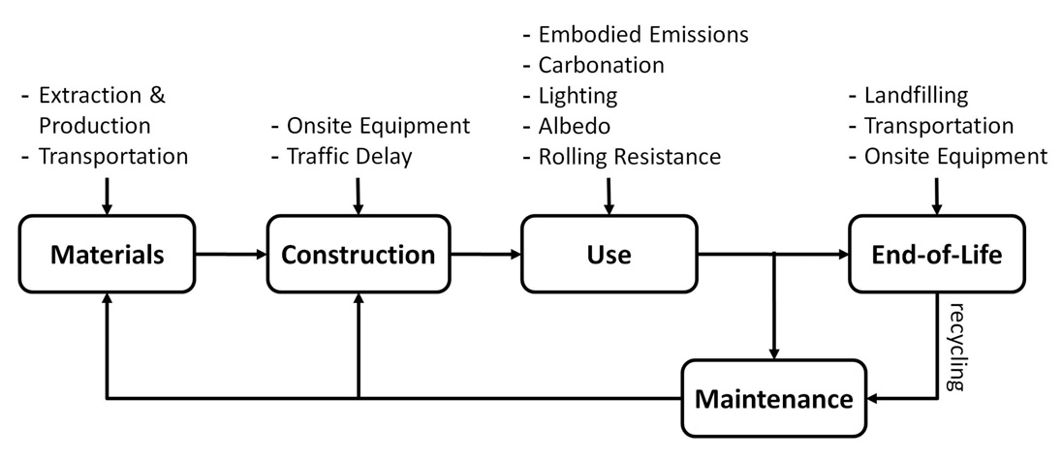
Boundaries

Slide 12
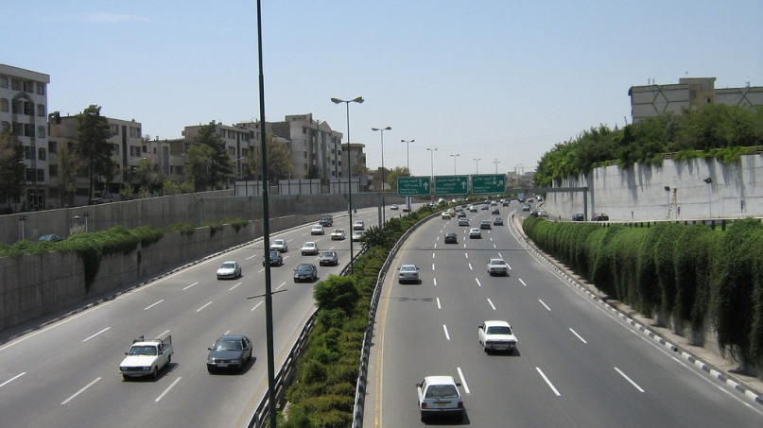
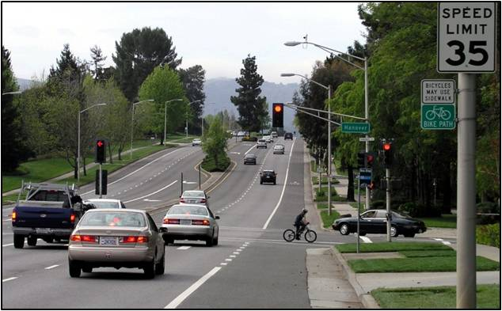
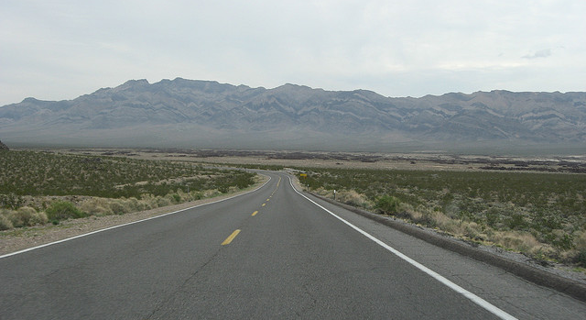
Functional Unit
High volume road
Moderate volume road
Low volume road
Notes:
They studied three categories of pavements including high volume roads, moderate volume roads, and low volume roads for both urban and rural settings.
12

Slide 13
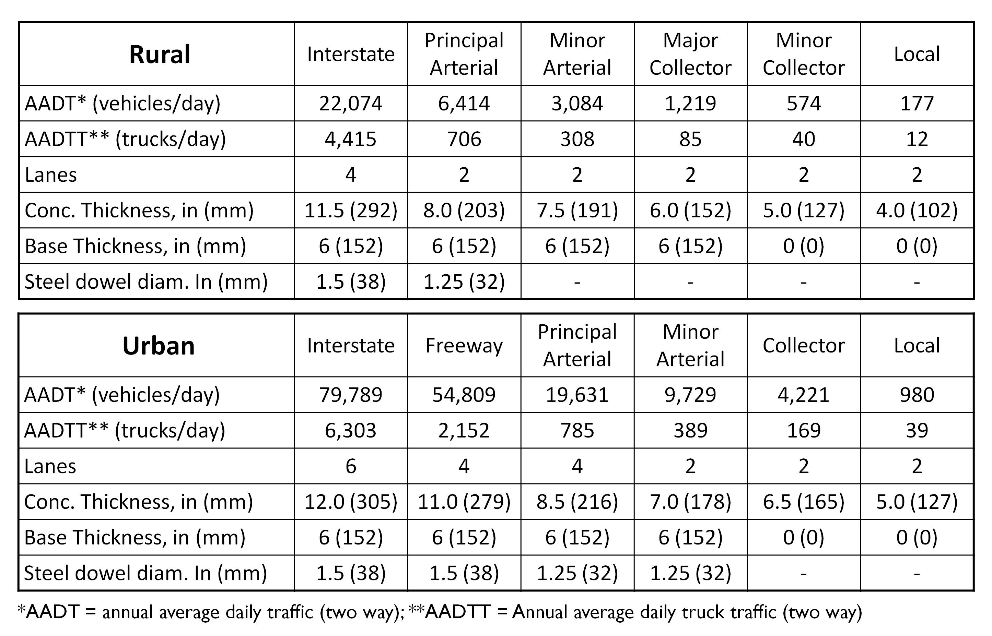
Functional Units
Notes:
LCAs were conducted on a total of twelve pavement designs based on FHWA (Federal Highway Administration) roadway classifications ranging from rural local roads to urban interstates. The designs were developed using 1993 AASHTO Method for the Design of Pavement Structures to capture the current state of practice used by most government agencies. Global Warming Potential (GWP), measured in terms of carbon dioxide equivalents (CO2e), were determined for each life cycle phase for the 12 pavement designs to quantify the relative importance of each life cycle phase and identify specific strategies to reduce GWP of concrete pavements.

Slide 14

Functional Unit
Length of one kilometer (or mile)

Slide 15
Impacts
Global Warming Potential (GWP) of concrete pavements:
  Rural Local Roads = 600 tons CO2e/mi (340 Mg CO2e/km)
  Urban Interstates = 11,000 tons CO2e/mi (6,300 Mg CO2e/km)
Note: CO₂e = Carbon Dioxide Equivalents (used as an indicator of GWP)
Notes:
Results from the research indicate:
-GWP of concrete pavements ranged from 600 tons CO2e/mi (340 Mg CO2e/km) on rural local roads to 11,000 tons CO2e/mi (6,300 Mg CO2e/km) on urban interstates.

Slide 16
Impacts
Greenhouse Gas Emissions (GHG) emissions from cement production are the largest contributor:
  Urban Interstates = 45%
  Rural Local Roads = 72%
Note: CO₂e = Carbon Dioxide Equivalents (used as an indicator of GWP)
Notes:
Results from the research indicate:
-GHG emissions from cement production are the largest contributor―45% for urban interstates to 72% for rural local roads

Slide 17
Impacts
For 9 of 12 pavement designs
Second largest contributor to GWP is fuel consumed from roughness
Note: CO₂e = Carbon Dioxide Equivalents (used as an indicator of GWP)
Notes:
- For 9 of 12 pavement designs, the second largest contributor to GWP is fuel consumed from roughness.

Slide 18
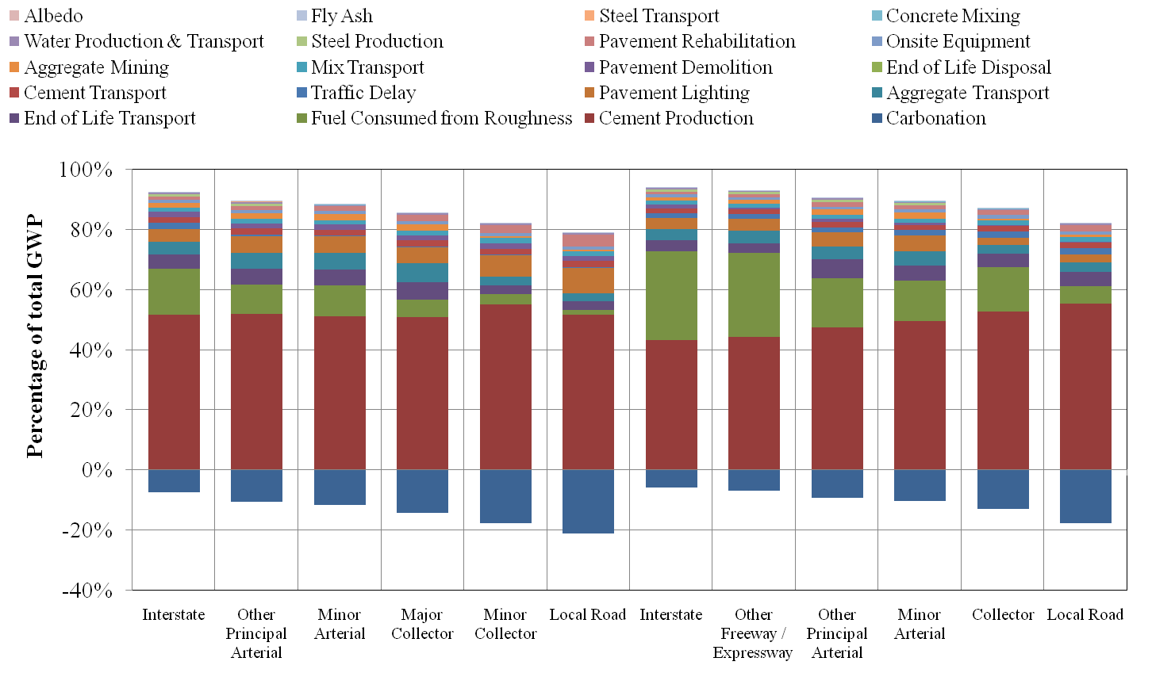
Relative GWP
Notes:
Graphically, cement production and fuel consumption from roadway roughness are clearly demonstrated to be significant contributors to Global Warming Potential (GWP).

Slide 19
Impact Reduction
Increase Fly Ash
  GWP could be reduced by 15% for urban interstates to 36% for local roads by increasing the percentage of fly ash in concrete from 10% to 30%.
Notes:
There are a number of potential GHG emissions reduction strategies for concrete pavements that were explored by MIT, and LCA provides guidance for future environmental improvements. Notable results regarding potential reduction strategies include:
- GWP could be reduced by 15% for urban interstates to 36% for local roads by increasing the percentage of fly ash in concrete from 10% to 30%

Slide 20
Impact Reduction
Increasing the albedo of concrete
Reduces the urban heat island effect resulting in 43% reduction in GWP
Opportunities for increasing albedo
  White aggregate
  White cement
  Pervious concrete
  Photocatalytic cement
  Two-lift paving (high albedo materials in top surface)
Notes:
-Increasing the albedo of concrete reduces the urban heat island effect resulting in 43% reduction in GWP

Slide 21
Impact Reduction
Carbonation
Crushing and stockpiling concrete for one year sequesters 28% of initial CO₂ released.
  EOL stockpiling
  EOL: embankments
  EOL: subbases
  Pervious concrete
Notes:
-Carbonation through crushing and stockpiling concrete for one year sequestered 28% of initial CO2 released.

Slide 22
Impact Reduction
Extra Rehabilitation
An additional rehabilitation (grinding) will reduce pavement roughness
Benefits LCA
  Reduces roughness to initial IRI (International Roughness Index)
  Uncarbonated concrete is exposed for the carbonation process to begin again
  Reduces GWP by 13% for urban interstates
  Increases GWP for rural local roads by 10%
Notes:
-Carbonation through crushing and stockpiling concrete for one year sequestered 28% of initial CO2 released.
-Reducing roughness through extra pavement rehabilitations reduces GWP by 13% for urban interstates but increases GWP for rural local roads by 10%.

Slide 23
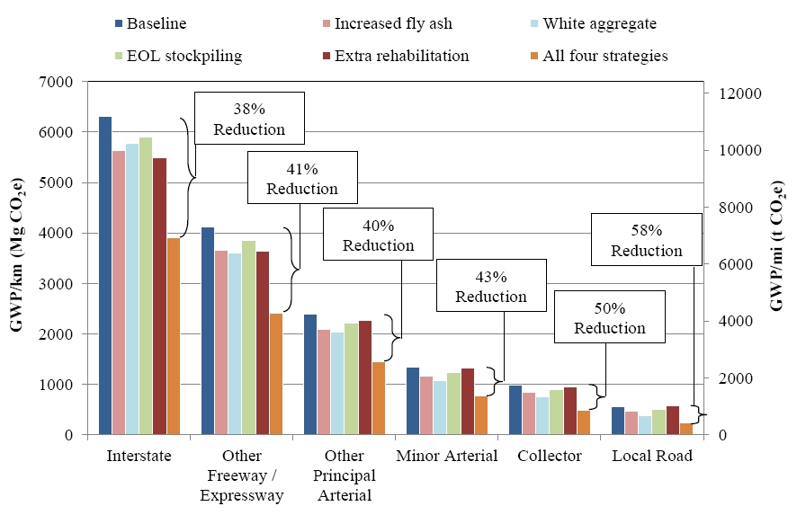
Impact Reduction
Notes:
Implementing all four strategies could decrease GWP from 38% for urban interstates to 58% for urban local roads

Slide 24
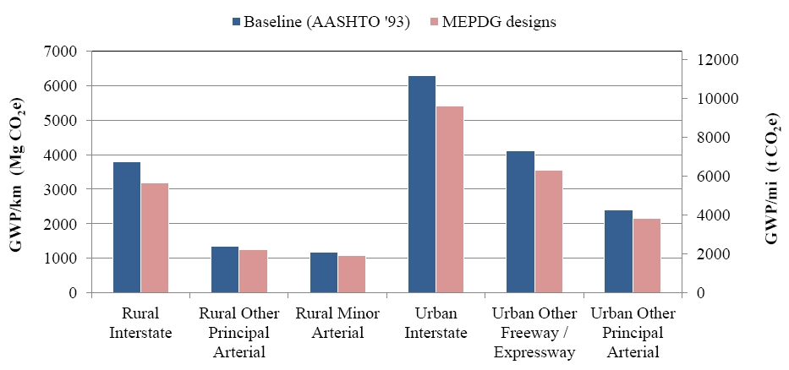
Impact Reduction
Notes:
Another way to decrease GWP is to provide more cost effective pavement designs using state-of-the-art design methodologies. For example, utilizing AASHTO Mechanistic Empirical Pavement Design Guide (MEPDG) in lieu of 1993 AASHTO Design Guide could reduce GWP by up to 17% for rural interstates.

Slide 25
Impact Reduction: Pavement Vehicle Interaction
LCA Boundary For High Volume Roadway
PVI ~ 70%
Resource Extraction
Processing
Placement
Use Phase
Recycling
Embodied Emissions: 20%
Operational Emissions: 80%

Slide 26
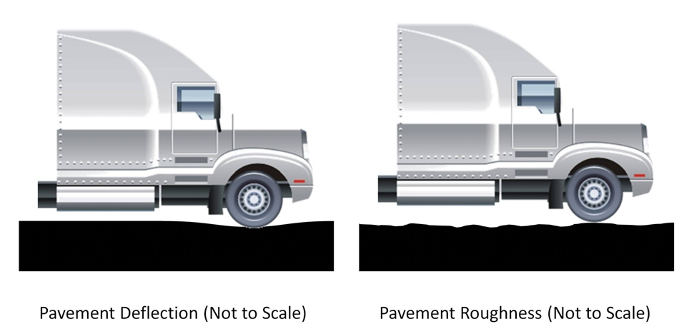
Pavement Vehicle Interaction
Mechanistic model for pavement deflection
Asphalt pavement 1.6 times thicker than an equivalent concrete pavement to achieve the same fuel consumption.
Notes:
Pavement-vehicle interaction (PVI) describes the effect of pavement properties on vehicle fuel consumption. The effect of PVI on fuel consumption over a full life cycle can be significant. Roughness and deflection are the main contributors to higher fuel consumption
MIT developed a mechanistic model to draw a relationship between pavement deflection and fuel consumption. It validated the model by comparing results to existing field data. The mechanistic model calculates that an asphalt pavement would need to be 1.6 times thicker than an equivalent concrete pavement to achieve the same fuel consumption.

Slide 27
Impact Reduction: Pavement Vehicle Interaction
50 yr GHG Emissions of Two Pavement Scenarios Relative to a “Flat” Pavement
Notes:
High volume road:
AADT: 25,000 (2500 trucks)
2 lanes in each direction
Arterial road:
AADT: 7500 (750 trucks)
2 lane in each direction
Not Considered:
- Added Roughness, etc.

Slide 28
More Information
Full report available from MIT Concrete Sustainability Hub at web.mit.edu/cshub
MIT Hub established by
  RMC Research & Education Foundations
  Portland Cement Association
NRMCA providing technical support
  Transfer research into practice
  Visit www.nrmca.org
Notes:
The full report titled The Effects of Inflation and Its Volatility on the Choice of Construction Alternatives can be downloaded from the MIT Concrete Sustainability Hub web site at http://web.mit.edu/cshub. The Concrete Sustainability Hub is a research center at MIT that was established by the Ready Mixed Concrete (RMC) Research & Education Foundation and the Portland Cement Association (PCA). NRMCA is providing technical input to the research program and helping transfer the research results into practice.

