Slide 1
MIT Research: Life Cycle Assessment of Commercial Buildings
Notes:
Life cycle assessment (LCA) offers a comprehensive methodology for evaluating the environmental impacts
of buildings. Recent research at the Massachusetts Institute of Technology (MIT) explored and advanced key areas relevant to the field of LCA including methodology, benchmarking and impact reduction.

Slide 2
Methodology
Standardized LCA methodology critical
Increase consistency of LCA
MIT proposes good practices for LCA
Notes:
A standardized LCA methodology is critical in order to increase the consistency of LCA for buildings. The MIT research supports standardization by proposing good practices for conducting LCA on buildings.

Slide 3
Methodology
Transparency of data
Define scope
Identify system boundaries
Define functional unit
Notes:
It is important that LCAs use a comprehensive life cycle perspective and provide transparency with regards to the data, scope, boundaries, functional units and other important LCA parameters.

Slide 4
Life Cycle Perspective
Notes:
Drawing boundaries to include all phases of the building life cycle—materials, construction, use (including operating energy), maintenance, and end of life—allows for an accurate representation of cumulative environmental impacts over the life of a building.

Slide 5
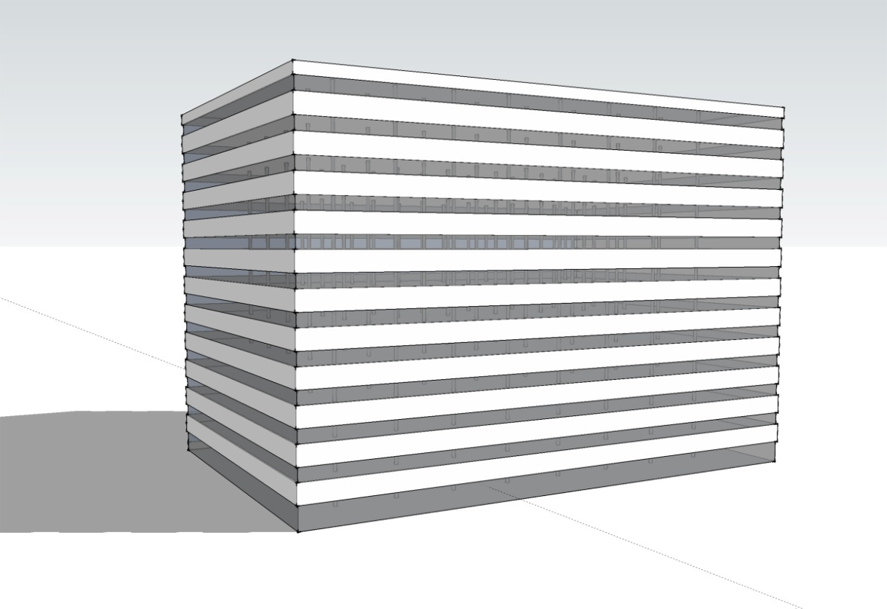
Benchmark Building
12 stories
498,590 ft²
Concrete
Steel
Phoenix
Chicago
Notes:
These methodologies were applied to a benchmark 12-story, 498,590 ft2 (46,321 m2) commercial building. The building was analyzed for two climates, Phoenix and Chicago, and for two different structural materials, concrete and steel.

Slide 6
Benchmark Analysis
Operating energy for 60-year life cycle
Global warming potential (CO₂e) quantified for several purposes
Benchmarking emissions of current construction practices
Comparing impacts of concrete versus steel
Understand relative magnitude of relative impacts of different life cycle phases
Notes:
The annual operating energy, determined using the EnergyPlus building energy analysis software, was conducted for a 60-year life cycle. The Global Warming Potential (GWP) was quantified using CO2-equivalents (CO2e) for several purposes, including benchmarking emissions for current construction practices, comparing impacts of concrete versus steel, and understanding the relative magnitude of impacts for different life cycle phases.

Slide 7
Impacts
Notes:
The analysis demonstrated that the greenhouse gas emissions due to operational energy of the benchmark buildings are responsible for 95-96% of life cycle emissions.

Slide 8
Embodied Emissions
Concrete and steel
Have similar embodied emissions
42 lbs CO2e/ft2 (205 kg CO2e/m2)
Embodied emissions include
Pre-use
Maintenance
End-of-life
Notes:
Compared to the steel structure, the concrete building has approximately the same embodied emissions (pre-use, maintenance and end-of-life phases) of 42 lbs CO2e/ft2 (205 kg CO2e/m2)

Slide 9
Thermal Mass Benefits
Concrete provides HVAC savings of 7-9% compared to steel frame
Accounts for 2% savings in annual operating emissions
Notes:
Thermal mass of an exposed concrete frame can provide HVAC savings of 7-9% compared to a steel frame. This accounts for 2% savings in annual operating emissions

Slide 10
Operational Emissions
Notes:
Over a lifetime of 60 years, the CO2e emissions of the concrete building were slightly lower than the steel alternative. The steel and concrete buildings have very similar emissions over the full life cycle, and the choice of structural material does not dramatically influence the total emissions.

Slide 11
Impact Reductions
Increasing SCM (such as fly ash) from 10% to 25%
Can decrease pre-use GWP by 4.3%
Lighting control and low-lift cooling
Can decrease the operating energy for concrete buildings
Notes:
Several recommendations for reducing life cycle emissions of concrete buildings were presented by MIT.
Increasing SCM substitution (such as fly ash) in the concrete building from 10% to 25% can decrease pre-use
GWP by 4.3%
Lighting control and low-lift cooling can decrease the operating energy requirements for concrete buildings. Low-lift cooling takes advantage of the high heat capacity of concrete and is effective when building cooling loads are reduced through control of internal and solar heat loads.

Slide 12
More Information
Full report available from MIT Concrete Sustainability Hub at web.mit.edu/cshub.
MIT Hub established by
RMC Research & Education Foundations
Portland Cement Association
NRMCA providing technical support
Transfer research into practice
Visit www.nrmca.org
Notes:
The full report titled Methods, Impacts, and Opportunities in the Concrete Building Life Cycle can be downloaded from the MIT Concrete Sustainability Hub web site at http://web.mit.edu/ cshub. The Concrete Sustainability Hub is a research center at MIT that was established by the Ready Mixed Concrete (RMC) Research & Education Foundation and the Portland Cement Association (PCA). NRMCA is providing technical input to the research program and helping transfer the research results into practice.

